Slide 1


THE SIMPLE PAST TENSE
REGULAR & IREGULAR VERB
ATIKA NUR HIDAYAH,S.PD

Slide 2
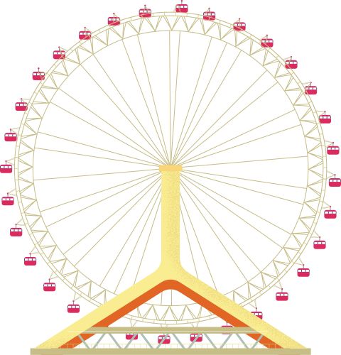
NEED TO KNOW!
We use the simple past tense to talk about actions happen in the past.
We add “-ed” to the verb to talk about past events.
“Last weekend, we visited the park.”

Slide 3
REGULAR VERB
(USE -ED)
(+) Subject + V1-ed + Object/Complement
(-) Subject + did not (didn't) + v1 + Object/Complement
(?) Did + Subject + v1+ Object/Complement?
Examples of Regular Verbs:
Walk → Walked
Play → Played
Listen → Listened
Start → Started
Love → Loved

Slide 4
BUT...
Some verbs do not accept “-ed” and we call them irregular verbs.
“Last weekend, we went to the park.”

Slide 5
IREGULAR VERB
(MUST BE MEMORIZED)
(+) Subject + v2 of Irregular Verb + Object/Complement
(-) Subject + did not (didn't) + v1 + Object/Complement
(?) Did + Subject + v1 + Object/Complement?
Examples of Irregular Verbs:
Go → Went
Eat → Ate
See → Saw
Have → Had
Make → Made
Run → Ran

Slide 6
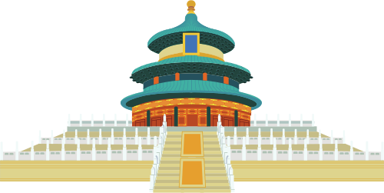
SOME EXAMPLES OF SENTENCES IN THE PAST TENSE

Slide 7
REGULAR VERB
(+) She cooked dinner last night
(dia memasak makan malam tadi malam)
(-) She didn’t cook dinner last night
(dia tidak memasak makan malam tadi malam)
(?) Did she cook dinner last night
(apakah dia memasak tadi malam?)

Slide 8
IREGULAR VERB
(+) I saw Johan at the party
(aku melihat johan di pesta itu)
(-) I didn’t see Johan at the party
(aku tidak melihat johan di pesta itu)
(?) Did you see Johan at the party?
(apakah kamu melihat Johan di pesta itu?)

Slide 9
DRAG & MATCH
Drag and drop the verbs next to their past forms.

Slide 10


build
break
speak
sleep
read
give
go
eat
write
ride
fly
drink
went
rode
drank
ate
spoke
read
wrote
slept
built
broke
flew
gave

Slide 11
ORDERING
Order the words to make a sentence.

Slide 12
1.
a novel
year
My sister
read
last
2.
slept
She
night
last
well
3.
We
with
my friends
in
spoke
the morning
4.
last
a letter
wrote
I
week
5.
rode
my car
He
to
the work
yesterday

Slide 13
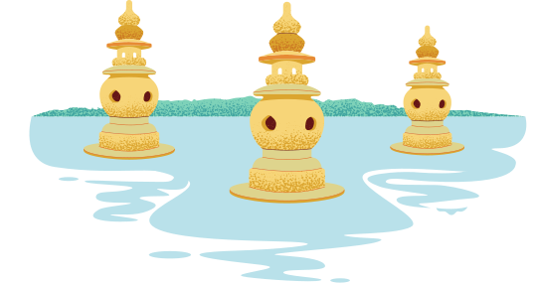
MULTIPLE CHOICE
Read and choose the best option.
Write the verb in the correct form.

Slide 14
I _________to school yesterday.
build
go
read

Slide 15
I _________pizza for dinner last night.
eat
drink
build

Slide 16
I _________my bicycle to the park yesterday.
ride
write
make

Slide 17
Birds _________over the bridge last night.
write
run
fly

Slide 18
I _________a great book last month.
fly
read
sleep

Slide 19
WELL DONE!

